Slide 1
Where drill down module
August 2021

Slide 2
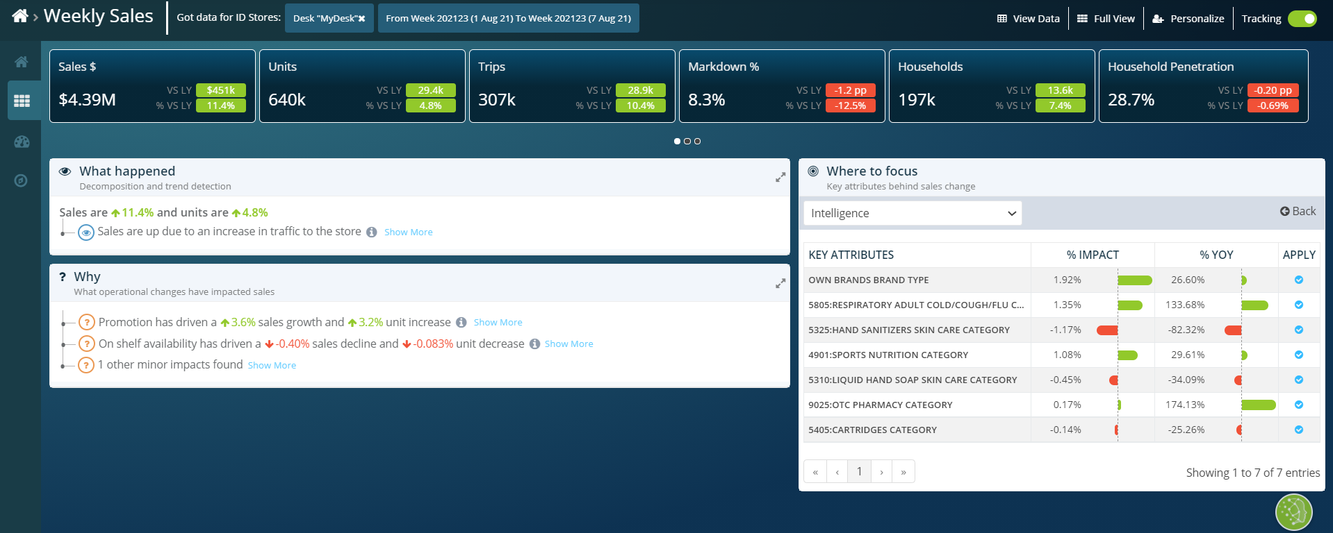
Sales are up because of more customers making trips to the store, however items from the desk are being bought in fewer baskets than last year (-4.6%), particularly with Quality Driven customers (-7.2%)
2 divisions, Denver (+20%) and IMW (+15%) account for 90% of the sales growth driven by an influx of customers to the store
3 divisions, NorCal, Shaws, Portland are showing large declines in sales, coming from a decline in trip penetration with Quality Driven customers. Actions with 500k opportunity identified

Slide 3
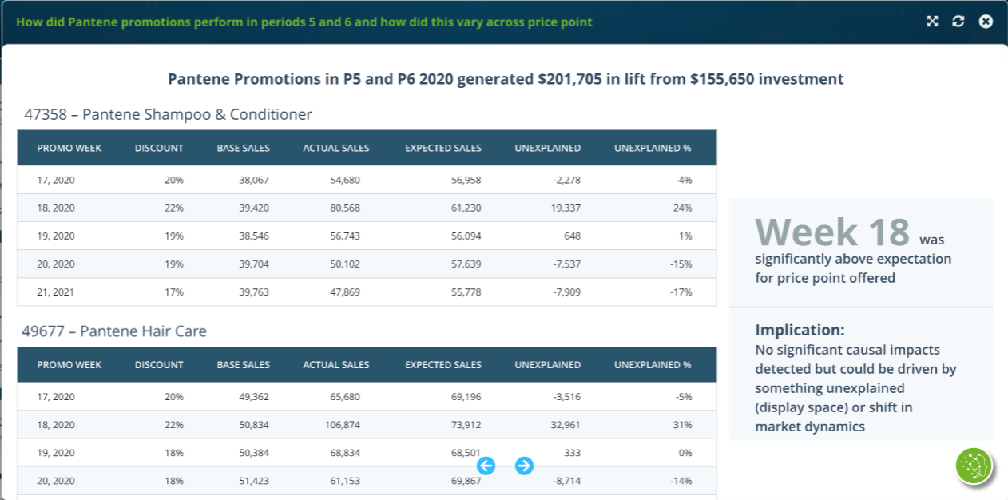
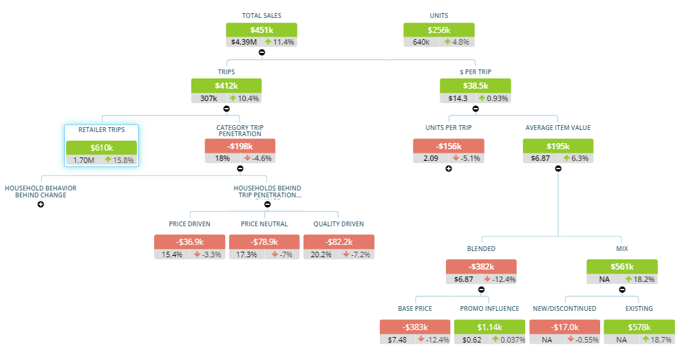
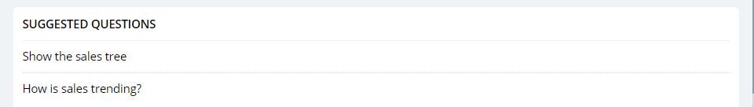
Show Sales Tree
Growth in trips to the overall store is increasing category sales by 15%
Overall store traffic is up, which is why desk sales are up, despite the desk being bought in 5% fewer trips
2 divisions, Denver (+20%) and IMW (+15%) account for 90% of the sales growth driven by an influx of customers to the store
3 divisions, NorCal, Shaws, Portland are showing large declines in sales, driven by a decline in trip penetration with Price Driven customers
Decline in trip penetration, particularly quality driven bringing down sales by 4.6%
AIV is having a positive influence on sales driven by a more premium mix of items being purchased
Overall AIV growth despite base prices down 12%
Show metric comparison view
Trend metrics

Slide 4
Show Sales Tree
Growth in trips to the overall store is increasing category sales by 15%
Overall store traffic is up, which is why desk sales are up, despite the desk being bought in 5% fewer trips
2 divisions, Denver (+20%) and IMW (+15%) account for 90% of the sales growth driven by an influx of customers to the store
3 divisions, NorCal, Shaws, Portland are showing large declines in sales, driven by a decline in trip penetration with Price Driven customers
Decline in trip penetration, particularly quality driven bringing down sales by 4.6%
Summary insights
Who?
When?
Where?
Why?
AIV is having a positive influence on sales driven by a more premium mix of items being purchased
Overall AIV growth despite base prices down 12%

Slide 5
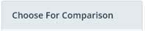
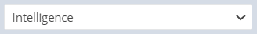
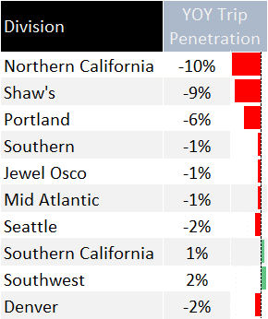
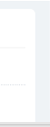
Divisions driving YOY Quality Driven Trip Penetration
Choose comparison metrics
Division
3 divisions driving the overall decline in Trip Penetration: NorCal, Shaws, Portland
Overall store traffic is up, which is why desk sales are up, despite the desk being bought in 5% fewer trips
2 divisions, Denver (+20%) and IMW (+15%) account for 90% of the sales growth driven by an influx of customers to the store
3 divisions, NorCal, Shaws, Portland are showing large declines in sales, driven by a decline in trip penetration with Price Driven customers
These 3 divisions are decreasing overall desk YOY sales by 4%
Map YOY trip penetration change
Trend YOY trip penetration change

Slide 6
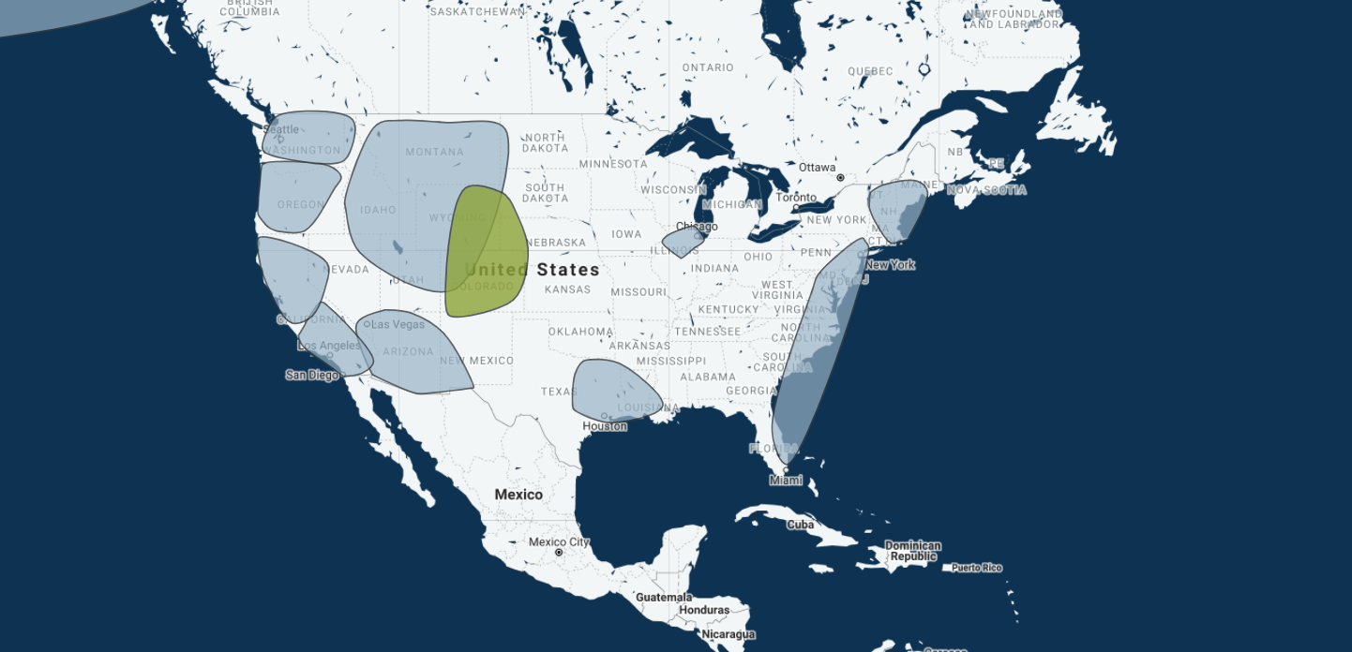
Mapped divisions driving YOY Quality Driven Trip Penetration
Choose comparison metrics
Division
3 divisions driving the overall decline in Trip Penetration: NorCal, Shaws, Portland
Overall store traffic is up, which is why desk sales are up, despite the desk being bought in 5% fewer trips
2 divisions, Denver (+20%) and IMW (+15%) account for 90% of the sales growth driven by an influx of customers to the store
3 divisions, NorCal, Shaws, Portland are showing large declines in sales, driven by a decline in trip penetration with Price Driven customers
These 3 divisions are decreasing overall desk YOY sales by 4%
Compare YOY trip penetration change
Trend YOY trip penetration change

Slide 7
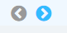
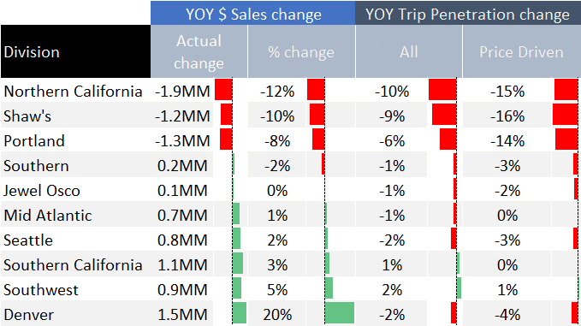
Divisions driving YOY Quality Driven Trip Penetration
Choose comparison metrics
Division
3 divisions, NorCal, Shaws, Portland are showing large declines in sales, driven by a decline in trip penetration with Quality Driven customers
Overall store traffic is up, which is why desk sales are up, despite the desk being bought in 5% fewer trips
2 divisions, Denver (+20%) and IMW (+15%) account for 90% of the sales growth driven by an influx of customers to the store
3 divisions, NorCal, Shaws, Portland are showing large declines in sales, driven by a decline in trip penetration with Price Driven customers
These 3 divisions are decreasing overall desk YOY sales by 4%

Slide 8
Quality Driven Trip Penetration by week by focus division by category for division Northern California
Northern California division
Week 23, 2021
5 categories are driving 80% of the decline in trip penetration
Overall store traffic is up, which is why desk sales are up, despite the desk being bought in 5% fewer trips
2 divisions, Denver (+20%) and IMW (+15%) account for 90% of the sales growth driven by an influx of customers to the store
3 divisions, NorCal, Shaws, Portland are showing large declines in sales, driven by a decline in trip penetration with Price Driven customers
Toothpaste is declining due to price increases on 5 key Price Driven lines, driving estimated 10% decline in Quality Driven Trip Penetration
Oral Rinse promotions have been cut for key promo driven lines, driving estimated 12% decline

Slide 9
Quality Driven Trip Penetration by week for division Northern California
Category Toothpaste
Northern California division
Week 23, 2021
Category Trip Penetration Trend by week
Overall store traffic is up, which is why desk sales are up, despite the desk being bought in 5% fewer trips
Decline in NorCal started week 9
2 divisions, Denver (+20%) and IMW (+15%) account for 90% of the sales growth driven by an influx of customers to the store
3 divisions, NorCal, Shaws, Portland are showing large declines in sales, driven by a decline in trip penetration with Price Driven customers
In week 9, promotion investment started to decline relative to prior year
Decline has been accelerating over the last 4 weeks

Slide 10
Quality Driven Trip Penetration by week for division Northern California
Last year promotions not repeated this year
Toothpase promotions have been cut on key promo lines for Quality Driven customers that have not been recovered by new promotions
Promotions on Colgate Whitening Toothpaste last year generated incremental $496k with Quality Driven customers that were not repeated
Recommended Action: Ensure competitive promotion price available for Quality and Promo driven customers, with Colgate the most important brand to include
Overall store traffic is up, which is why desk sales are up, despite the desk being bought in 5% fewer trips
2 divisions, Denver (+20%) and IMW (+15%) account for 90% of the sales growth driven by an influx of customers to the store
3 divisions, NorCal, Shaws, Portland are showing large declines in sales, driven by a decline in trip penetration with Price Driven customers

Slide 11
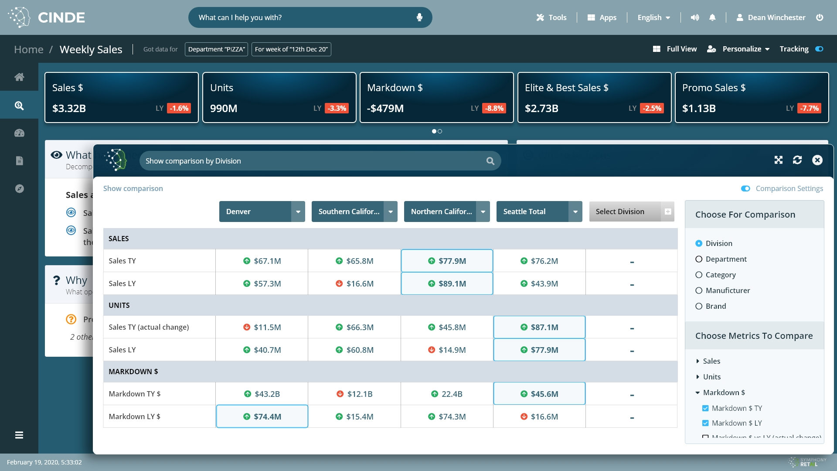
Toggle: actual and vs LY values
Sales
3.1%
3.1%
3.1%
Units
CUSTOMER
Households
Primary penetration
PROMOTION
Markdown $
% Good promotions

Slide 12
Quality Driven Trip Penetration by week by focus division by category
Top actions with most opportunity
Work in progress
Overall store traffic is up, which is why desk sales are up, despite the desk being bought in 5% fewer trips
Division: Northern California, Category: Toothpaste:
Bring back promotions on Colgate that drive Quality Driven customers. These promotions brought incremental $496k to the category from increased Quality Driven penetration
Division: Shaw’s, Category: Oral Rinse:
Bring pricing on 5 key items back in line with market, to increase Price Driven penetration by 5%
Division Northern California, Category: Deodorant:
Bring back or launch alternative for discontinued Sure brand which was highly incremental to the category
2 divisions, Denver (+20%) and IMW (+15%) account for 90% of the sales growth driven by an influx of customers to the store
3 divisions, NorCal, Shaws, Portland are showing large declines in sales, driven by a decline in trip penetration with Price Driven customers

Slide 13
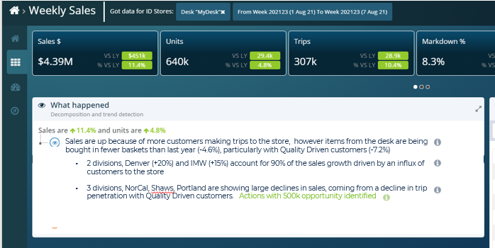
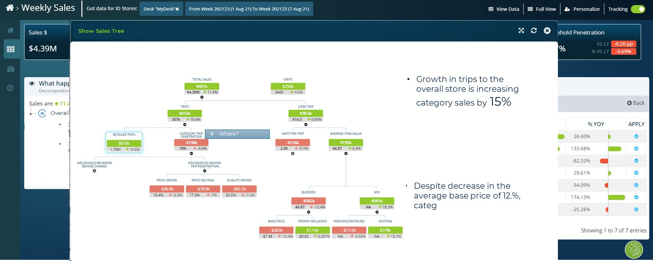
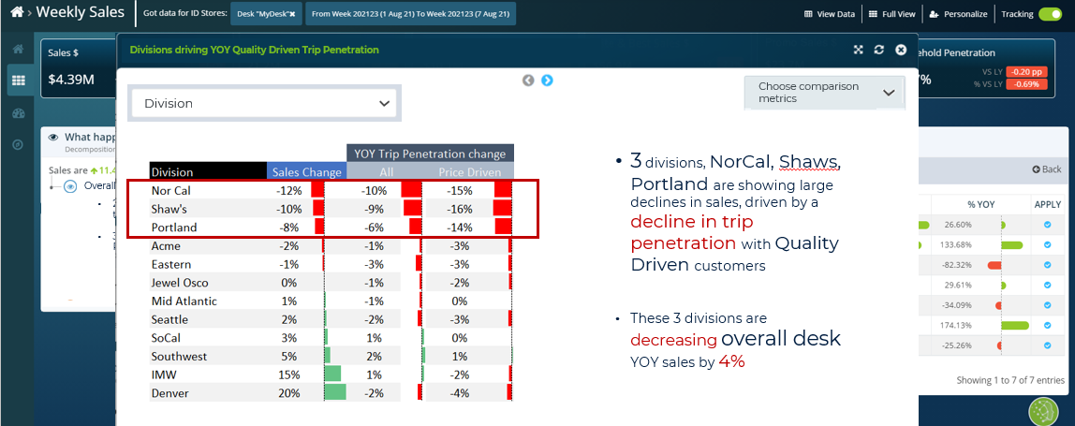
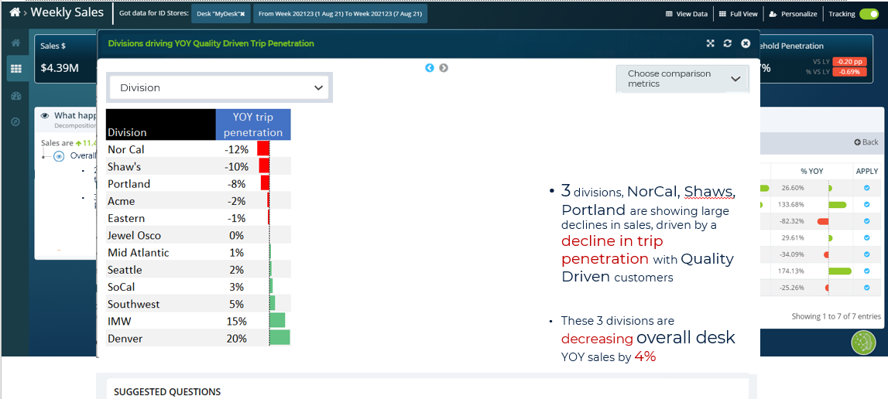
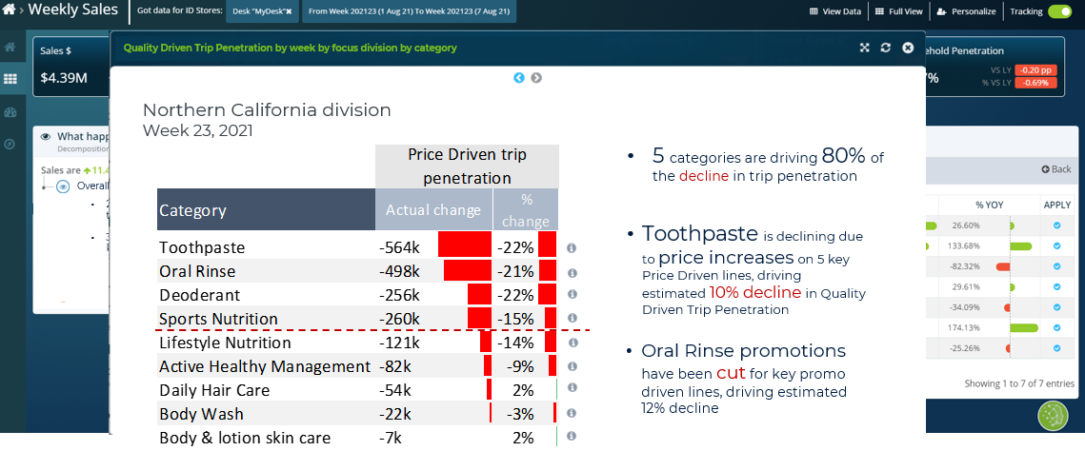
Draft priority actions for v1 release for National To be discussed / validated / scoped
Division breakdown intelligence included in Weekly Sales / Cat Review /Watchlists
Where breakdown available within each sales tree node

